Slide 1
“To be OR not to be,
that is the question”
William Shakespeare's play Hamlet. Act III, Scene I

Slide 2

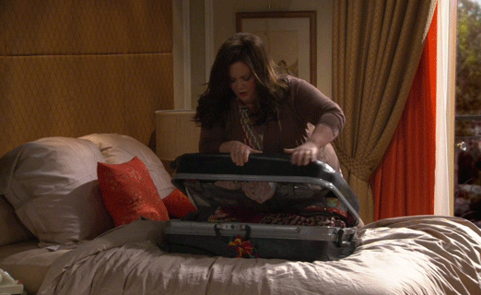
Moving to a new city, ROCHESTER
G O O G L E
W A I T !!

Slide 3
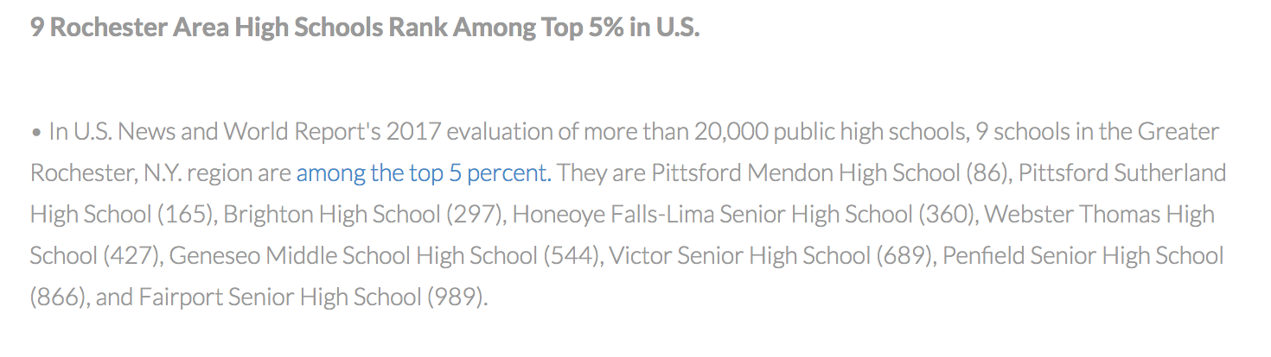
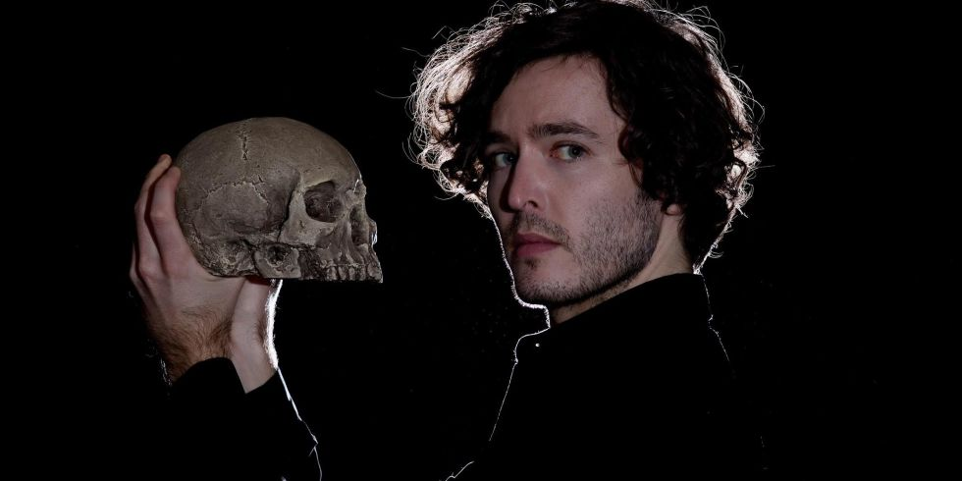

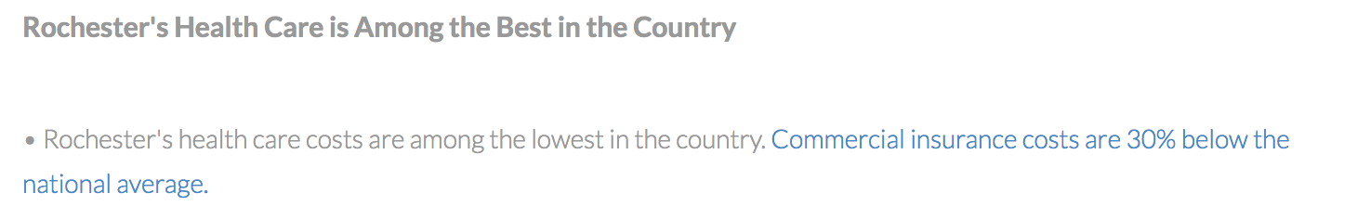
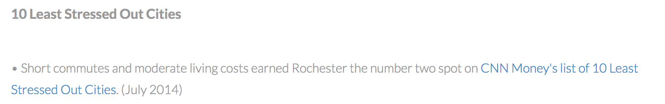
Less Stress
Great Health Care
What about SAFETY ??
Affordable Homes
Good Schools
http://www.rochesterbiz.com/DoingBusinessHere/BusinessInformation/RochesterRankings.aspx

Slide 4
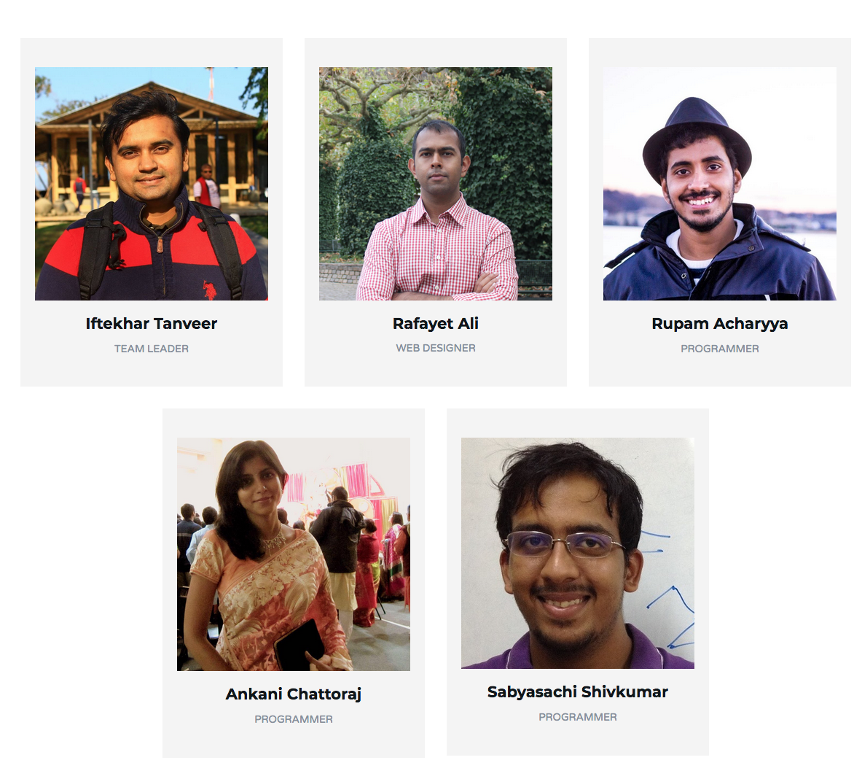
Hello!
We are “The Soothsayers”
Can we actually warn people?
“BEWARE THE IDES OF MARCH”
William Shakespeare's play Julius Caesar

Slide 5
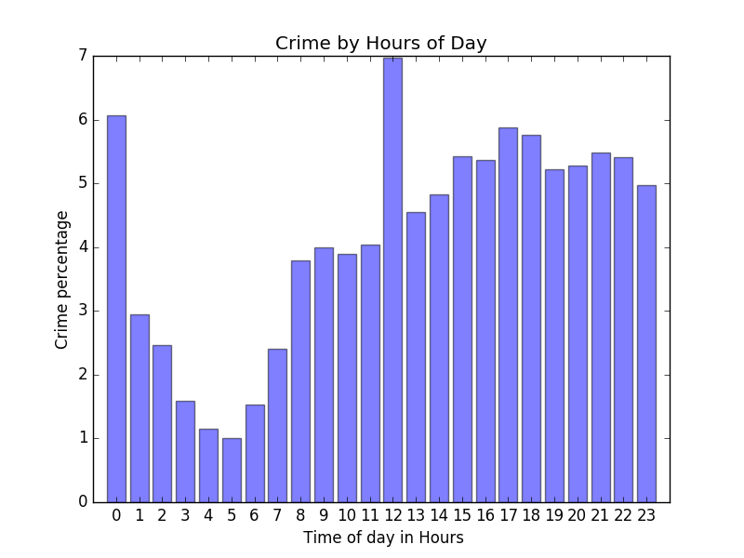
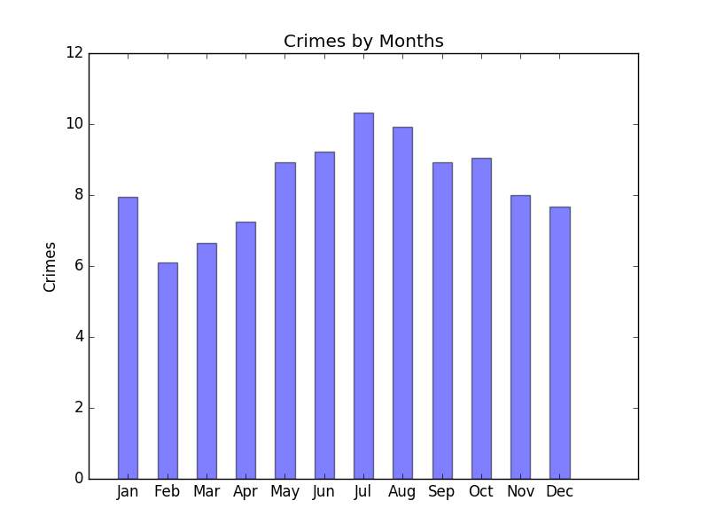
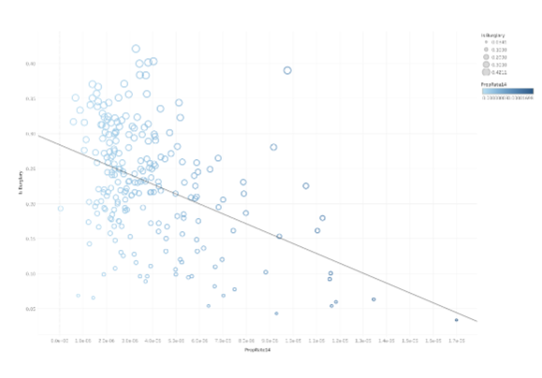
Initial Analysis of Rochester Crime Data
Crime at its pick during Summer and Fall
Midnight and Noon are high crime occurence times
Burglary is less in regions with high property rate

Slide 6
Geographically Weighted Regression
C Brunsdon, S Fotheringham

Slide 7
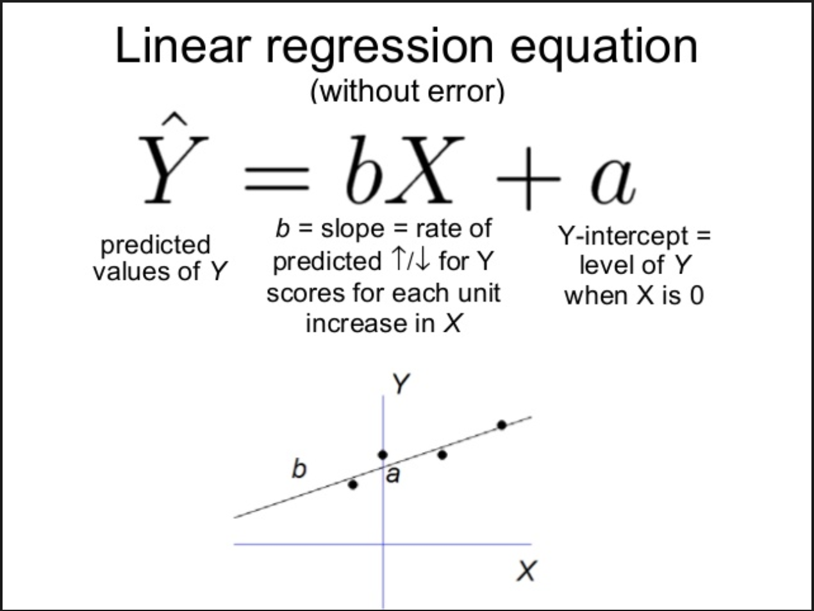
GWR Intuition

Slide 8
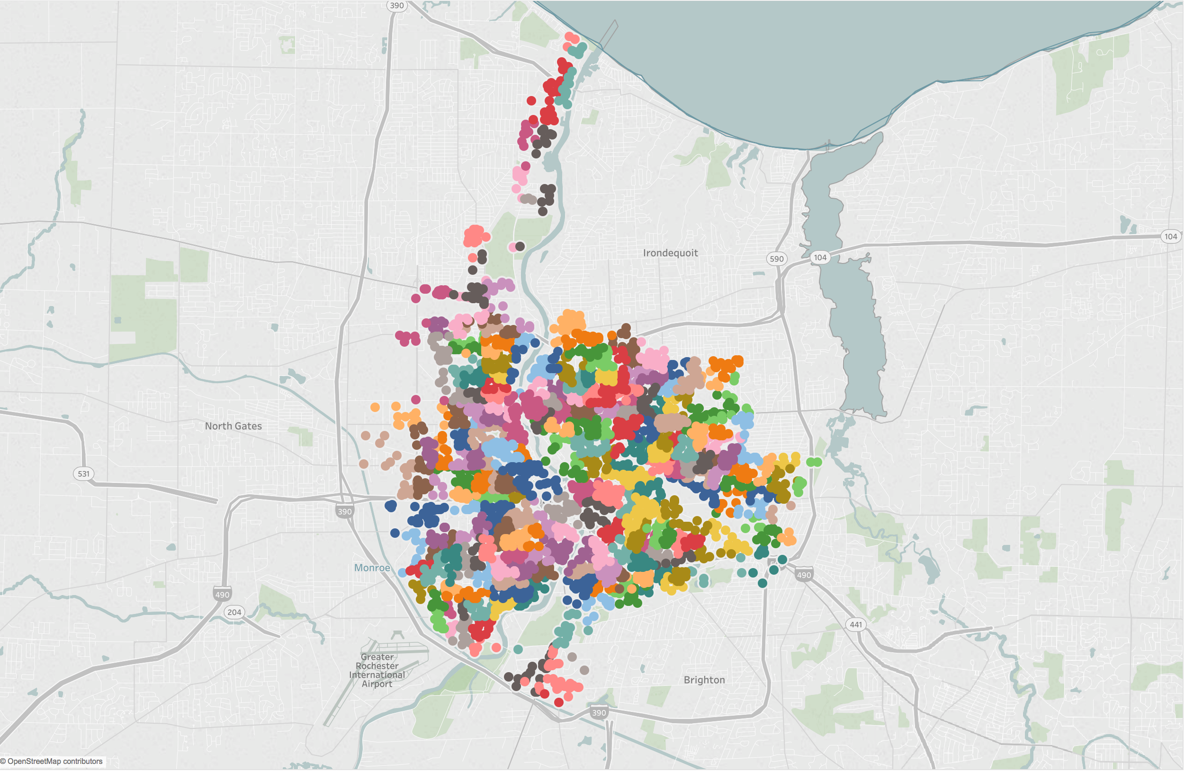
GWR Intuition

Slide 9
GWR Intuition

Slide 10
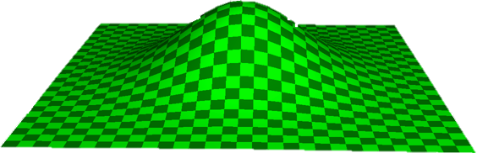

Slide 11
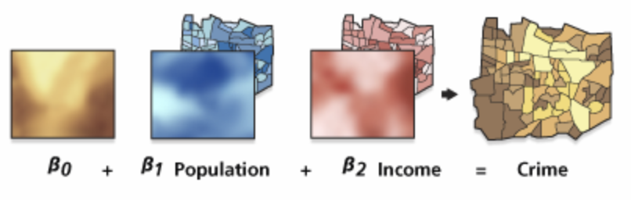
GWR Intuition

Slide 12
GWR Prediction

Slide 13
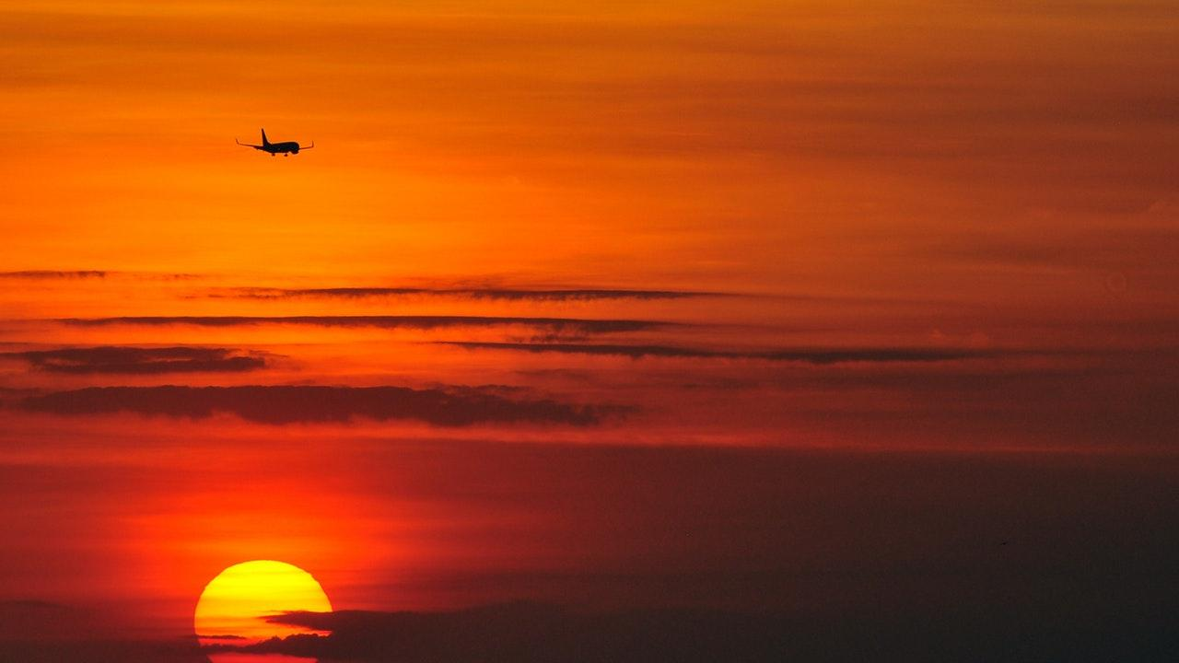
WEBSITE that tells you crime probabilities of an area
The website has a “locate me” option to locate your position.
It then tells you about the probabilities of various crimes in that area based on model predictions for that geoid.
The next step is to extend the model for temporal observations besides spatial.
The idea for future is to design an app that people can use on their phones.

Slide 14
Thank you for listening!!
HAVE A SAFE DAY!

